Slide 1

Smart Emergency HealthCare
Hina Gandhi

Slide 2

Problem Statement
The smart city should have the facility of solving car accidents quickly where the patient case is registered in nearest hospital before he arrives and all the requirements are set beforehand. The faster communication between different organizations will take place through internet of things.

Slide 3
Solution
Sensor in car calls the Emergency Health Services of a city (EHS) whenever it hits a car, person, bus or truck.
The admin of EHS will find the ambulance operator closest to accident area through IOT.
The ambulance operator will find the nearest hospitals from accident area through IOT.
A case will be registered in the nearest hospital and all the person and accident details are given by ambulance operator to the hospital
While ambulance is on way, the hospital makes required preparations before the arrival of patient.

Slide 4
ROLES
System Admin Role
Area Admin Role.
Ambulance Operator Role
Doctor Role
Receptionist Role
Emergency Health Services Admin Role
Hospital Admin Role
Ambulance Operator Role

Slide 5
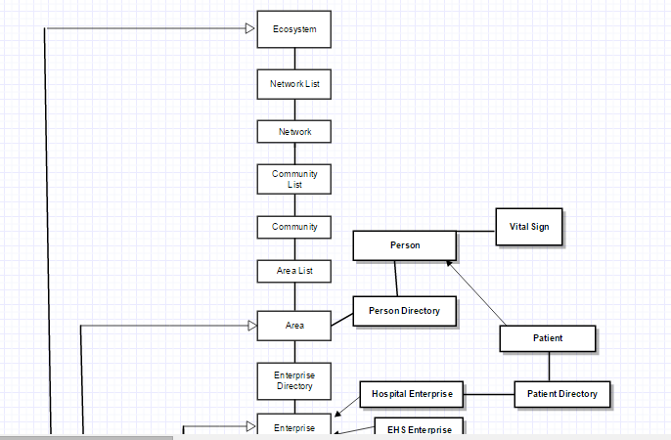
Object Model

Slide 6
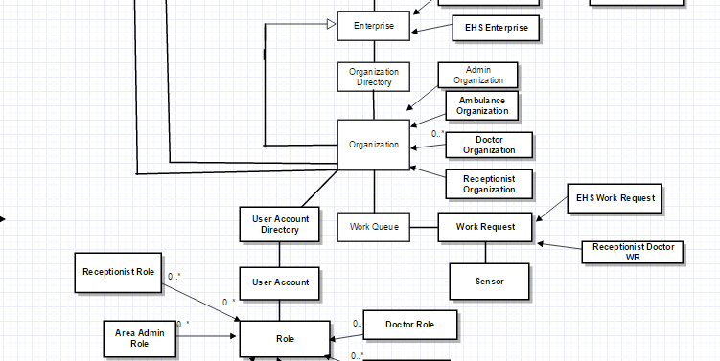
Object Model

Slide 7
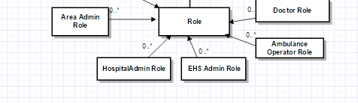
Object Model

Slide 8
Key Features
Unique identification of a person worldwide
Accident determination by sensor
The city EHS department will immediately ask ambulance operator to take action
Every ambulance operator has latitude and longitude values that is obtained through sensor
Every hospital enterprise has latitude and longitude
EHS will find nearest ambulance operator based on availability
Reporting patient case in nearest hospital
Real time health monitoring of patient
Response time measurement and analysis by city admin

Slide 9
Extra Features
Every person has unique identification and is uniquely identified worldwide
Random generation of accident and vital signs
Scheduling of accidents after every 5 second
Accident reported worldwide will be handled
Real time graphs of vital signs and alert indicator for deteriorating conditions
Distance calculation of accident area and hospital
Distance calculation of ambulance and accident area

Slide 10
THANK YOU!!

